Slide 1
Introduction to Operations Research
SYE 1010
Dr. MD Sarder

Slide 2
Blending Problem
What is blending problem?
Blending problems are a typical application of mixed integer-linear programming (MILP). They involve blending several resources or materials to create one or more products corresponding to a demand. Mixed integer-linear programs are linear programs in which some variables are required to take integer values.
What is the purpose of blending?
  Blending and mixing can be used to improve the quality of products, evenly coat particle materials, disperse liquids, or fuse materials. You may need to blend to achieve certain characteristics in an end product such as adjusting consistency or smoothing texture.

Slide 3
Blending Problem
What is blending LP?
If you work in a chemical industry or food factory, you need to make products by mixing various materials. For example, if you want to produce a medicine, you need the necessary elements for it and you have to mix them in a defined proportion. In addition, you have to keep in mind how many of these elements you need to buy, how your products’ quality will be, and so on. In this case, you need to optimize the mixing amount of the products that you want to deliver to the customers. The solution to this problem is provided by the Blending Linear Programming application.
Types of blending problem - Fixed Recipe refers to the scenario where you know the exact ratio or mixing amount of the materials. On the other hand, if you don’t have to use a defined amount of raw materials in the production of a commodity, then you should apply Blending LP for Flexible Recipe.

Slide 4
Blending Problem (fixed) Example
Imagine that you have three types of liquid materials A, B, and C. You will make two new products using A-B and A-C with a combination of 60%-40% and 80%-20% respectively. There are other parameters like Revenue/Liter, Cost/Liter, and the number of raw materials available in the factory. What is the blending strategy that will maximize the profit out of this scenario?
Material | A | B | C | Revenue/L | Min. Requirement (Gal.)
A |  |  |  | $1.25 | 45
B |  |  |  | $1.10 | 0
C |  |  |  | $2.00 | 200
A-B |  |  |  | $1.75 | 100
A-C |  |  |  | $1.20 | 55
Cost/L | $1.00 | $1.20 | $0.90
Availability (Gal.) | 170 | 200 | 220

Slide 5
Blending Problem (fixed) Setup
Blending Linear Programming Problem for Fixed Recipe
Material | A | B | C |  | Produced (Gal.) | Revenue/L | Min. Requirement (Gal.)
A | 100% |  |  |  |  | $1.25 | 45
B |  | 100% |  |  |  | $1.10 | 0
C |  |  | 100% |  |  | $2.00 | 200
A-B | 60% | 40% |  |  |  | $1.75 | 100
A-C | 80% |  | 20% |  |  | $1.20 | 55
Cost/L | $1.00 | $1.20 | $0.90 |  |  | Revenue
Raw Usage (Gal.) |  |  |  |  |  | Cost
 | ≤ | ≤ | ≤ |  |  | Profit
Availability (Gal.) | 170 | 200 | 220
Liter per Gallon | 3.7854

Slide 6
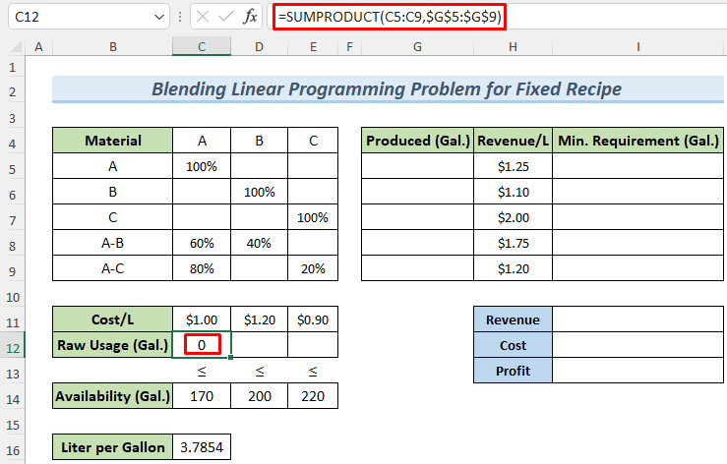
Blending Problem (fixed) Solver Step-1

Slide 7
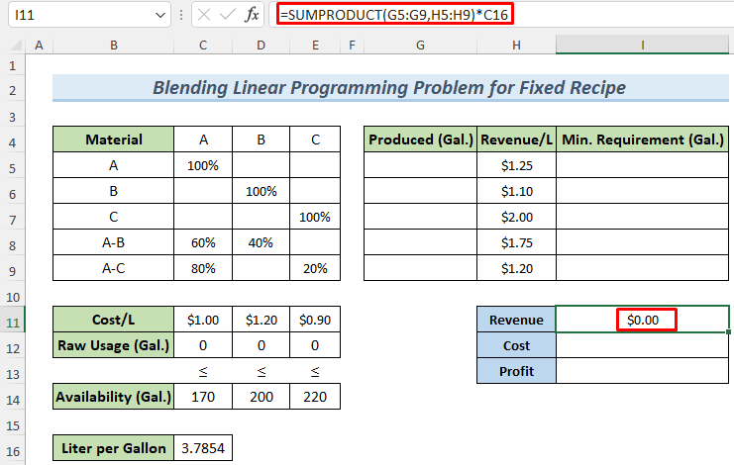
Blending Problem (fixed) Solver Step-2

Slide 8
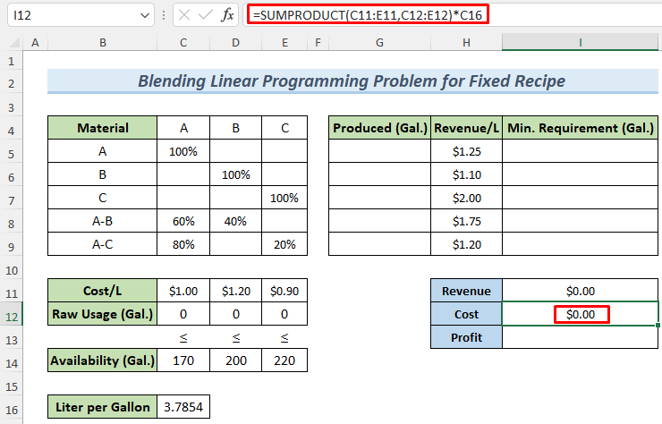
Blending Problem (fixed) Solver Step-3

Slide 9
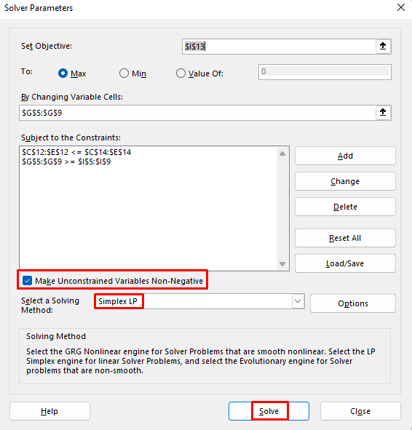
Blending Problem (fixed) Solver Step-last

Slide 10
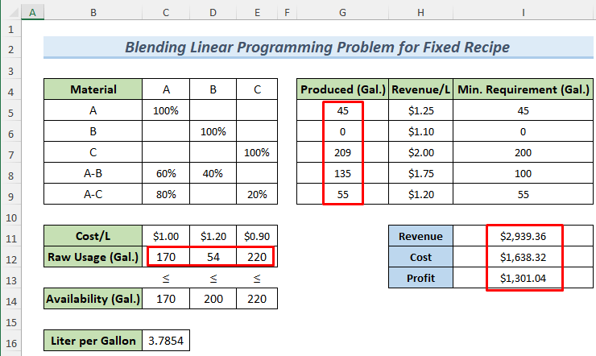
Blending Problem (fixed) Optimal Solution

Slide 11
Blending Problem (variable) Example
Imagine that you will produce different types of steel like regular, exclusive and super quality steel from the mixture of different raw materials. We have the data about how much of these raw materials are available, the cost of these raw materials per ton, and the quality rating of them. We also have the required production amount, price per ton of produced different classes of steels and their minimum rating. There is another parameter which we call the Linearized Rating. What is the blending strategy that will maximize the profit out of this scenario?
Process | Regular | Exclusive | Super |  | Availability (Tons) | Raw Cost | Raw Rating
1 |  |  |  | ≤ | 130 | $200.00 | 70
2 |  |  |  | ≤ | 200 | $180.00 | 76
3 |  |  |  | ≤ | 180 | $250.00 | 90
Steel Produced
 | ≥ | ≥ | ≥
Req. Production | 100 | 150 | 150
Price | $220.00 | $200.00 | $300.00
Minimum Rating | 75 | 75 | 89

Slide 12
Blending Problem (flexible) Setup
Process | Regular | Exclusive | Super | Usage |  | Availability (Tons) | Raw Cost | Raw Rating
1 |  |  |  |  | ≤ | 130 | $200.00 | 70
2 |  |  |  |  | ≤ | 200 | $180.00 | 76
3 |  |  |  |  | ≤ | 180 | $250.00 | 90
Steel Produced
 | ≥ | ≥ | ≥
Req. Production | 100 | 150 | 150
Price | $220.00 | $200.00 | $300.00 |  |  | Revenue
Minimum Rating | 75 | 75 | 89 |  |  | Cost
 |  |  |  |  |  | Profit
Linearized Rating
 | ≥ | ≥ | ≥

Slide 13
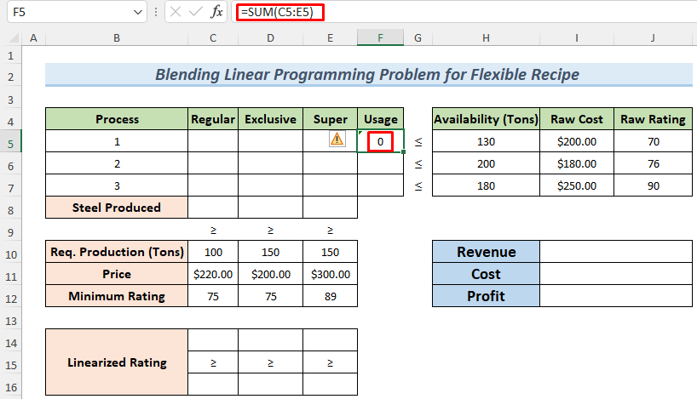
Blending Problem (flexible) Solver Step-1

Slide 14
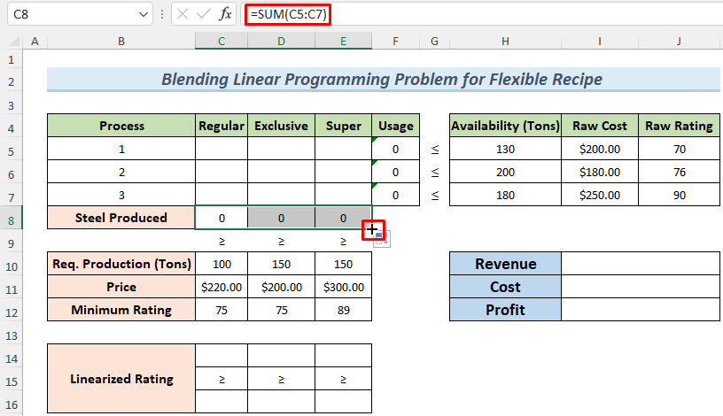
Blending Problem (flexible) Solver Step-2

Slide 15
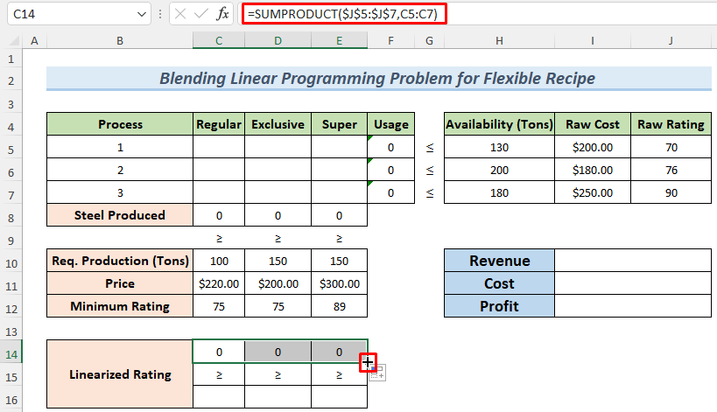
Blending Problem (flexible) Solver Step-3

Slide 16
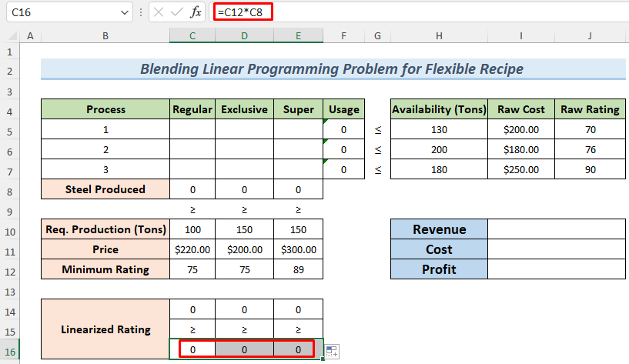
Blending Problem (flexible) Solver Step-4

Slide 17
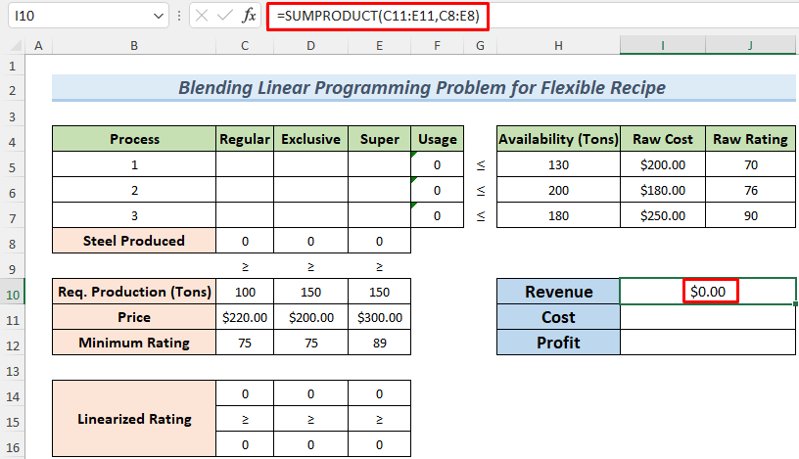
Blending Problem (flexible) Solver Step-5

Slide 18
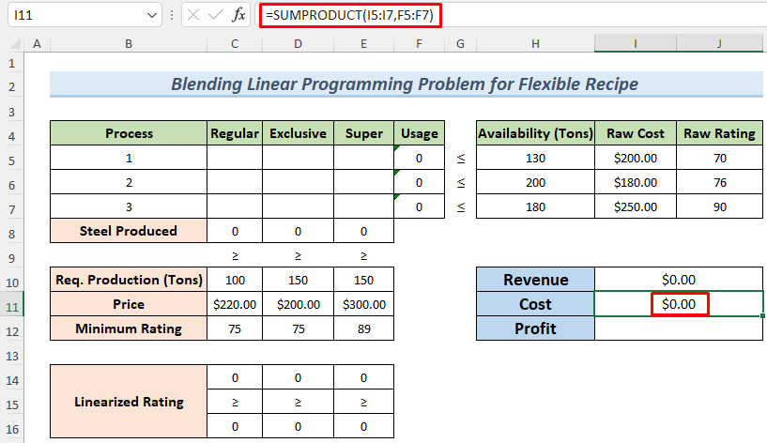
Blending Problem (flexible) Solver Step-6

Slide 19
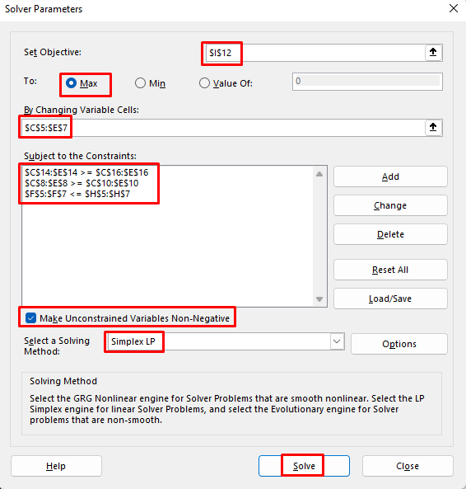
Blending Problem (flexible) Solver Step-last

Slide 20
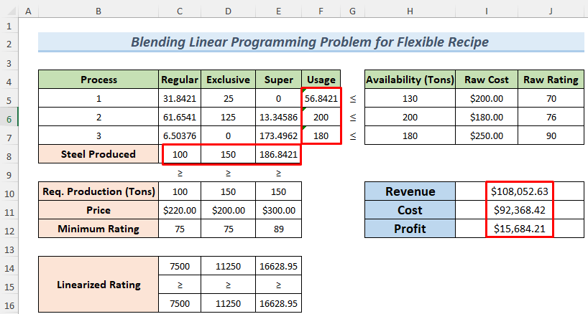
Blending Problem (flexible) Optimal Solution

Slide 21
Blending Problem (flexible) Do it Yourself
Process | Regular | Exclusive | Super | Usage |  | Availability (Tons) | Raw Cost | Raw Rating
1 |  |  |  |  | ≤ | 120 | $175.00 | 70
2 |  |  |  |  | ≤ | 205 | $170.00 | 75
3 |  |  |  |  | ≤ | 188 | $255.00 | 92
Steel Produced
 | ≥ | ≥ | ≥
Req. Production | 120 | 125 | 100
Price | $120.00 | $250.00 | $200.00 |  |  | Revenue
Minimum Rating | 77 | 72 | 90 |  |  | Cost
 |  |  |  |  |  | Profit
Linearized Rating
 | ≥ | ≥ | ≥

Slide 22
Linear Programming Problems
Product Mix Problem
Blending Problem
Production Scheduling Problem
Transportation Problem
Flow Capacity Problem

